Slide 2
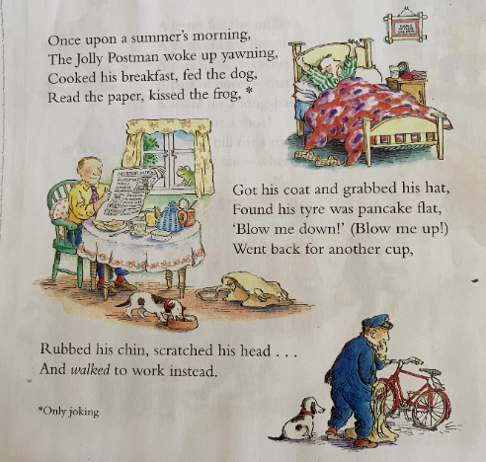
Can you find all of the
verbs? Your doing well if
you can find ten or more!
Verbs are doing words. A verb can express a physical action (jump), a mental action (guess), or a state of being (exist). It is the main part of a sentence: every sentence has a verb. In English, verbs are the only kind of word that changes to show past or present tense.

Slide 3
Activity One
Write about someone you know using verbs. Start with the opening line from ‘The Jolly Pocket Postman’ and use the third person. Third-person is writing from another person’s point of view or as an outsider looking in using pronouns such as: ‘he’, ‘she’, ‘it’ or ‘they’.
Once upon a summer’s morning,
Mrs Maloney woke up yawning,
Boiled an egg, burnt some toast,
Made a pot of tea, went for a wee!* Only joking
Read her emails, painted her toenails,
Got dressed and grabbed her bag,
Drove to school and sang I am cool!

Slide 4
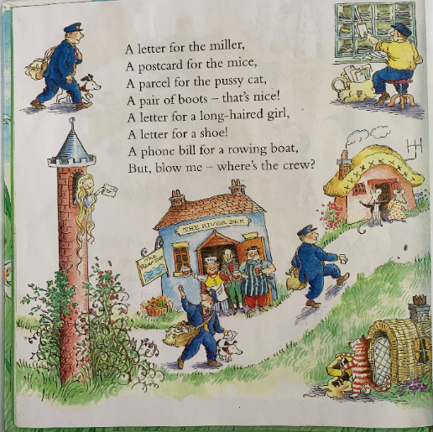

Slide 5
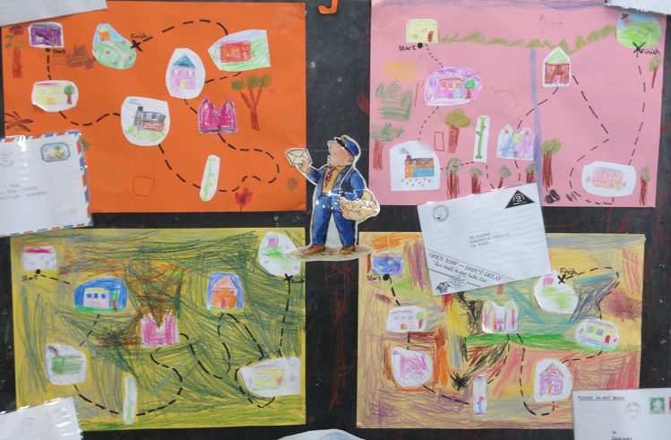
Activity Two
Create a map to show the ‘Jolly Pocket Postman’s journey. Remember he has visited the miller, the mice, a pussy cat, a long-haired girl, a shoe and someone living in a rowing boat! Remember to be creative and have fun!
What is a map? What do we use it for? Why might a postman need a map?

Slide 6
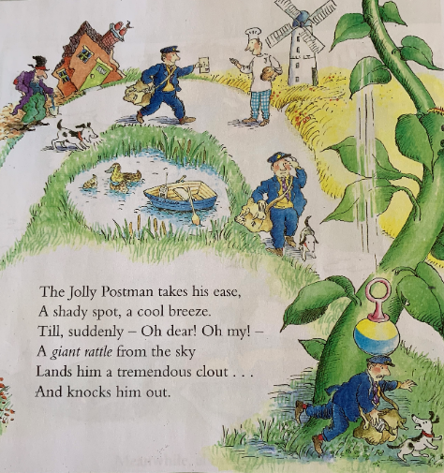

Slide 7
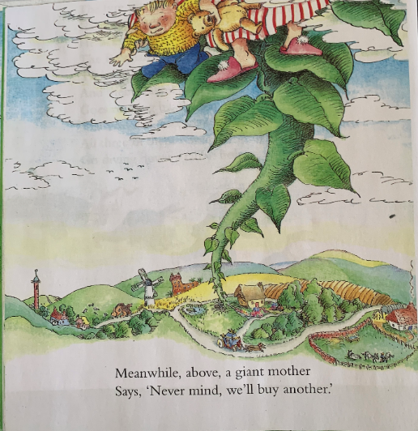
Activity Three
The giant baby has
lost his giant
rattle!
Create a lost poster
for the giant baby.

Slide 8
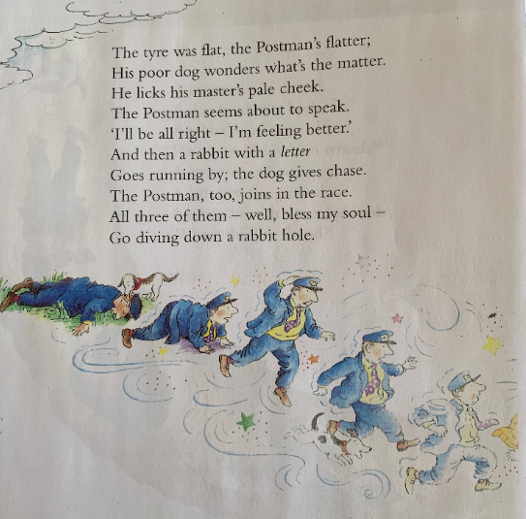

Slide 9
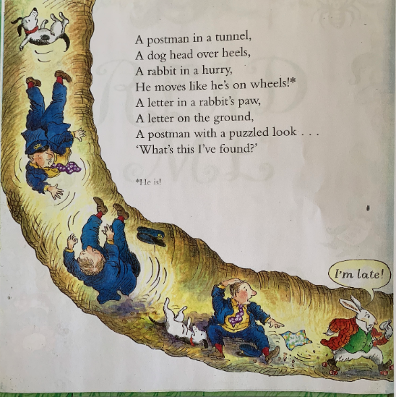

Slide 10
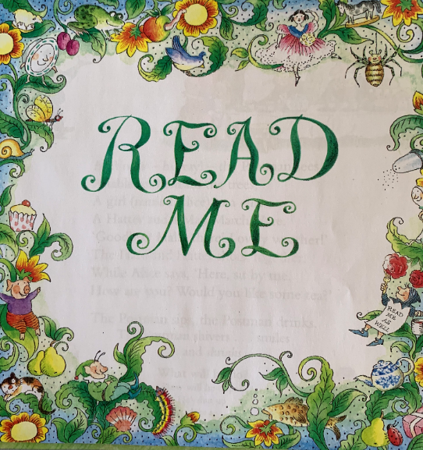
Activity Four
Create a poster
warning the Jolly
Pocket Postman
not to drink the
tea at any cost! Remember to
include adjectives
to describe the tea
and be creative it
Shouldn’t be a
normal cup of tea!

Slide 11
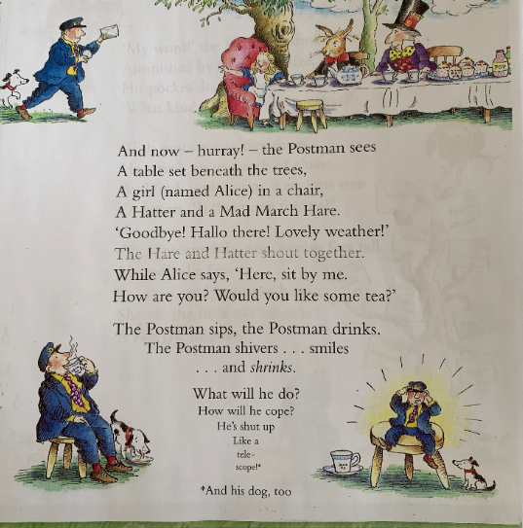

Slide 12
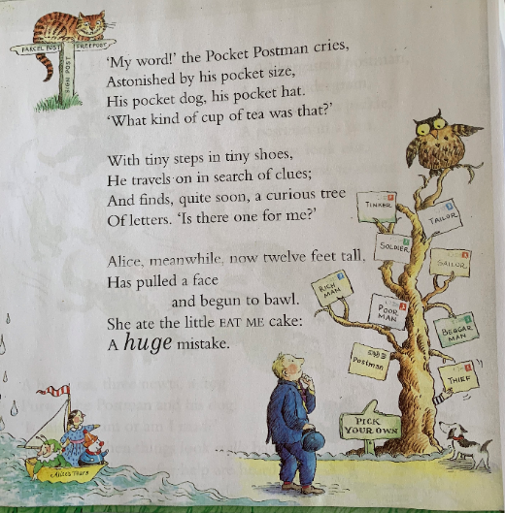

Slide 13
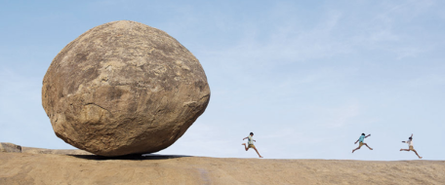
Activity Five
Watch: https://www.youtube.com/watch?v=_av5kqcMVm4
Dad’s home science experiment had gone horribly wrong! He had zapped the kids
in the garden with his new ELECTROZORBTASTICLASERJETBRAIN-GUN, which was supposed to make his three children the smartest children in the entire world. Instead, the zap had back-fired, making Dad even more brainy, but the children…Extremely tiny!
Stood in the middle of the garden path, they suddenly found themselves running as fast as they could away from a rolling pebble (which was actually tiny, but now seemed as big as a house).
Imagine you are one of the children. Can you draw what you might be able to see? Perhaps you are in the garden, or on the kitchen table, or inside somebody's lunch box! Remember: you're really small! Write a story about your adventures.

Slide 14
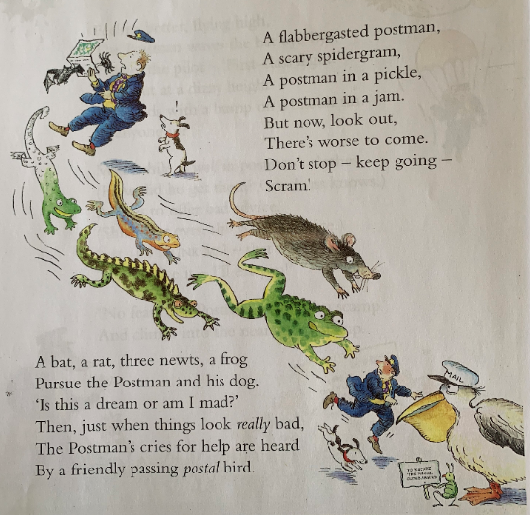

Slide 15
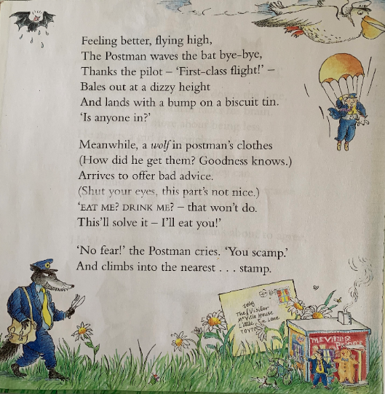

Slide 16
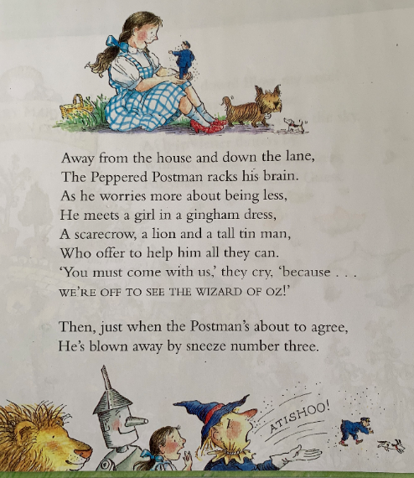
Activity Six
If you could join Dorothy and her friends to ask the Wizard of Oz to grant you one wish what would you wish for?
Write a short description of what you would wish for and draw a detailed illustration.

Slide 17
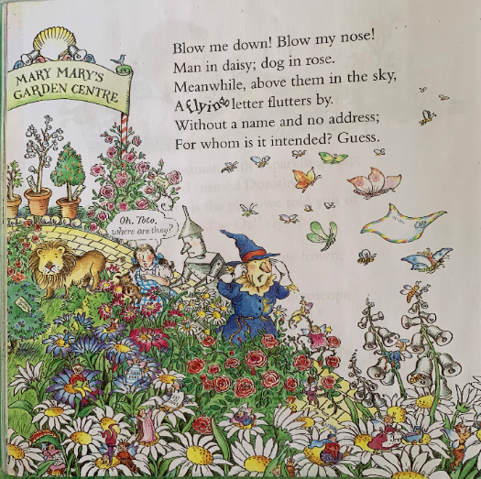

Slide 18
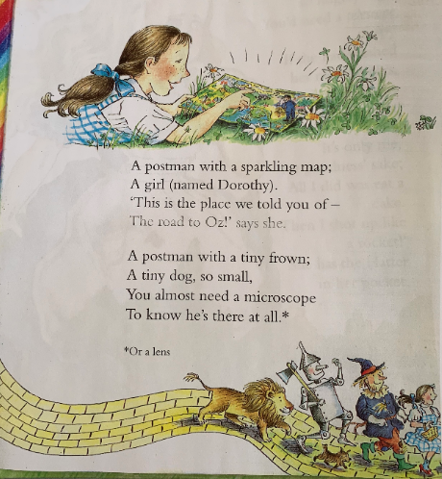

Slide 19
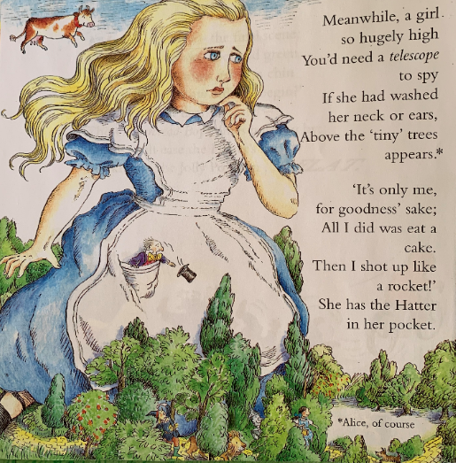
Activity Seven
Pretend you have shot up like a rocket. Draw a bird’s eye view of your street and the local area.

Slide 20
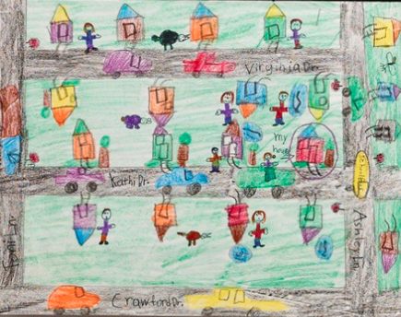
Draw a bird’s-eye view of your neighbourhood streets or map the way from home to school.
Pretend you are a bird or in an areoplane looking down on the street where you live. What do you see? Houses? Rooftops? Shops? Roads? Junctions? With an adult (during your daily walk or bike ride) go on a walk or cycle around your neighbourhood. Talk about the street signs and buildings you see. Then draw your own map.
Add streets and junctions close to your home. Which ones do you travel on the way to school?
Draw the building where you live and the other houses where you live. What would a bird see? Add details such as a swing set, fence, pets, steps, or patio.
Colour in other buildings. Add details such as cars, stop signs, street lights, or people.
Identify your house and label the streets on your map. If friends used your map, could they find their way around?

Slide 21
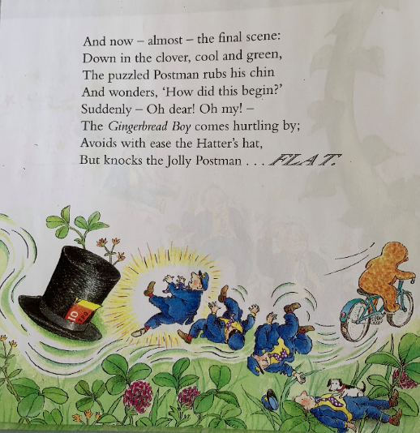
For fun….
Bake a gingerbread
family!

Slide 22
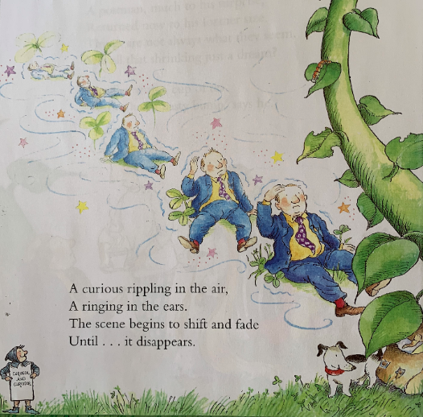

Slide 23
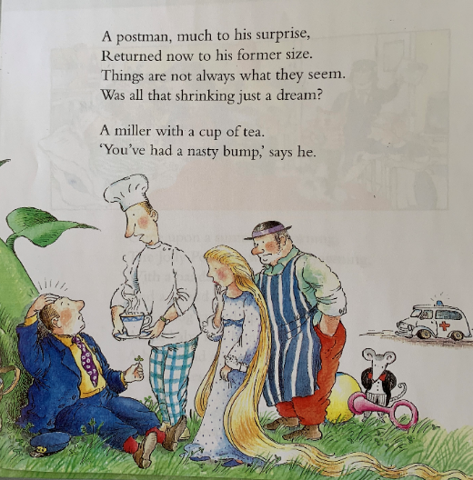

Slide 24
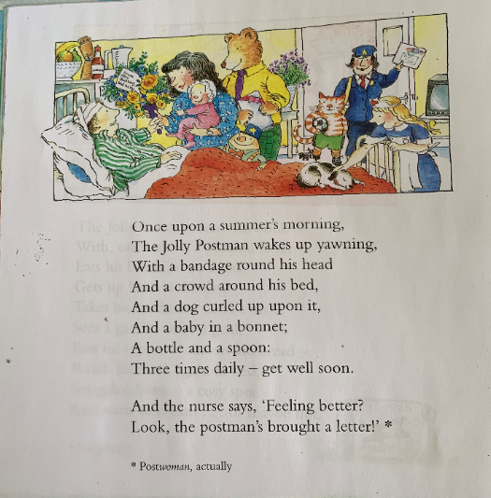

Slide 25
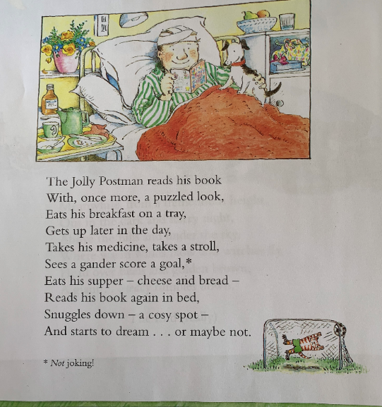

Slide 26
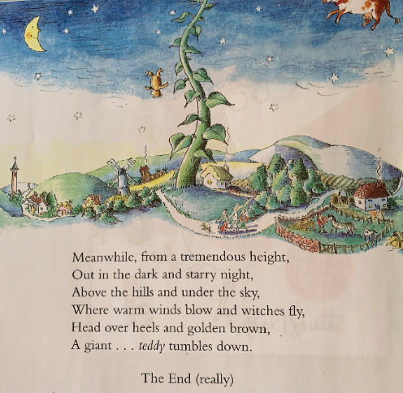
Activity 8
Write a letter to
Mrs Whiley
Millbrook C.P School
Kirkby Row
Kirkby
Liverpool
L32 0TG
Tell me anything
you want. Don’t
forget your return
address so that
I can send you a
reply!

