Slide 1
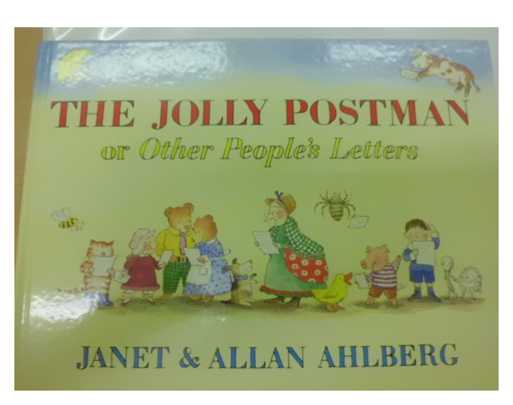

Slide 2
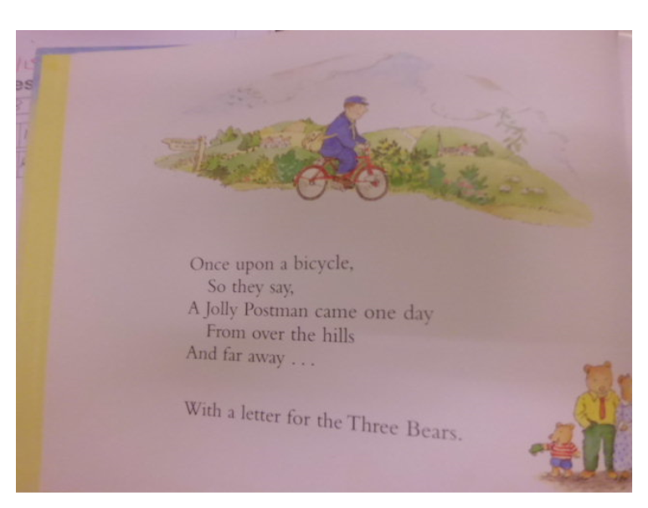

Slide 3
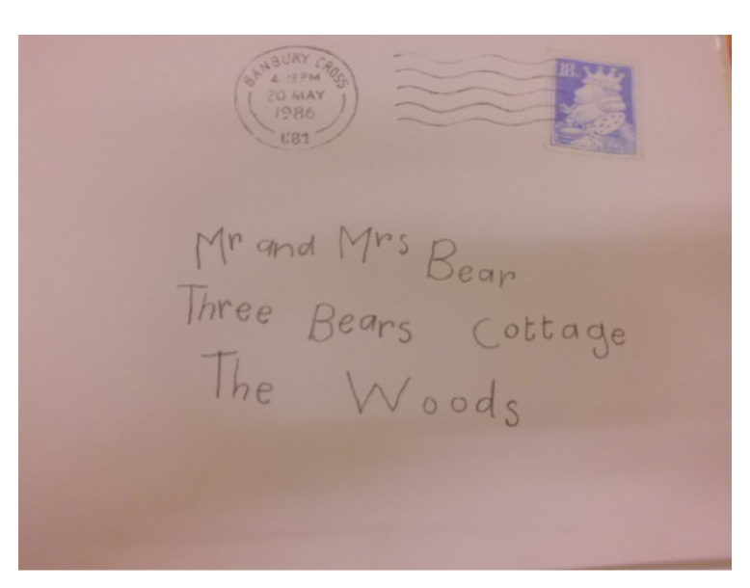

Slide 4
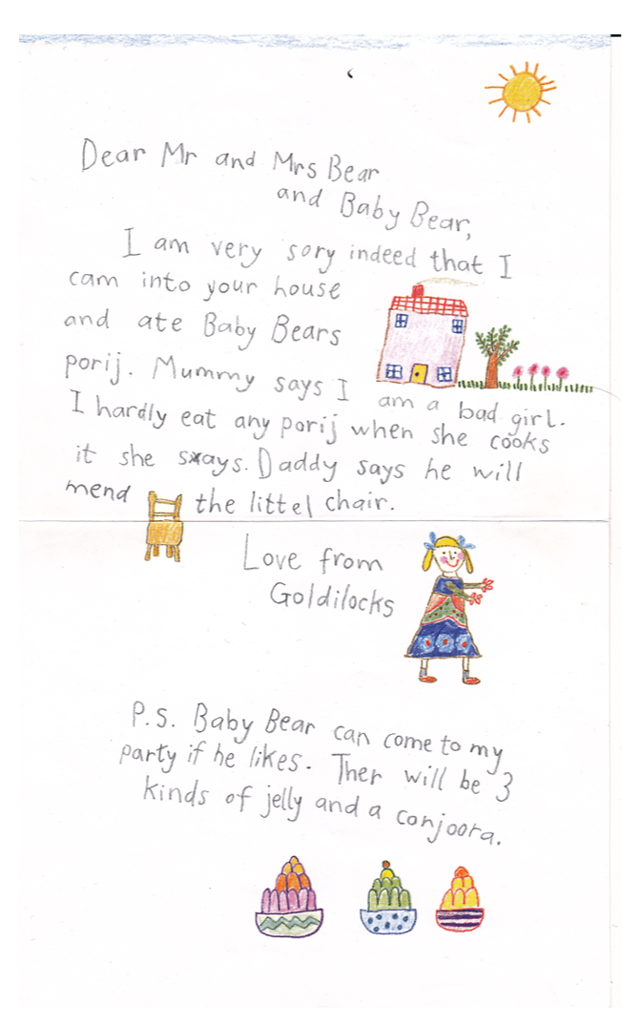
Activity One :
Write an apology letter using the first person (as if you are Goldilocks). You can write a better letter than Goldilocks! Remember your address at the top right hand side, use subordinate conjunctions and better vocabulary. Remember to write in the past tense. Look at an example letter from Jack Horner on the next slide.

Slide 5
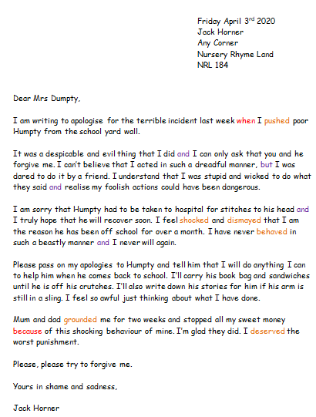
Key
Red words: Subordinate conjunctions
https://www.bbc.co.uk/bitesize/topics/zwwp8mn/articles/zqk37p3
Orange: Past tense words. Remember to use the suffix ‘ed’ at the end of past tense words. Use ‘we did’ or ‘I did’ not ‘we done’ or’ I done.’
Purple: Coordinating conjunctions
https://www.bbc.co.uk/bitesize/topics/zwwp8mn/articles/z9wvqhv

Slide 8
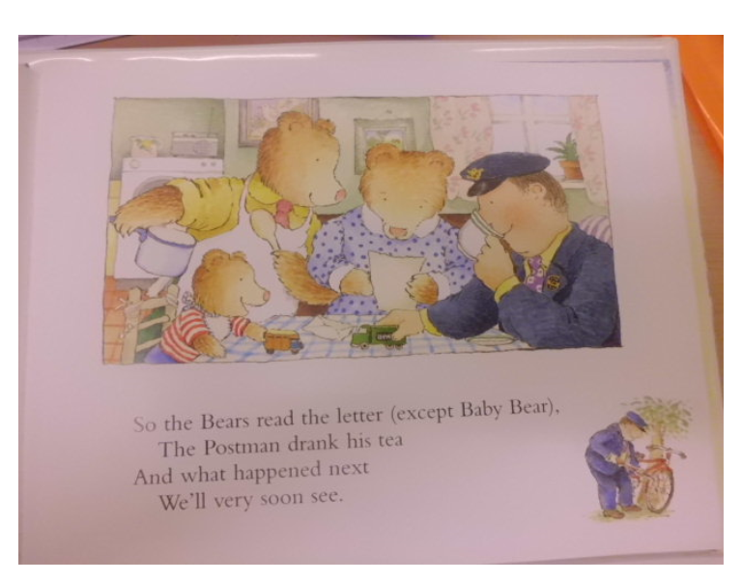

Slide 9
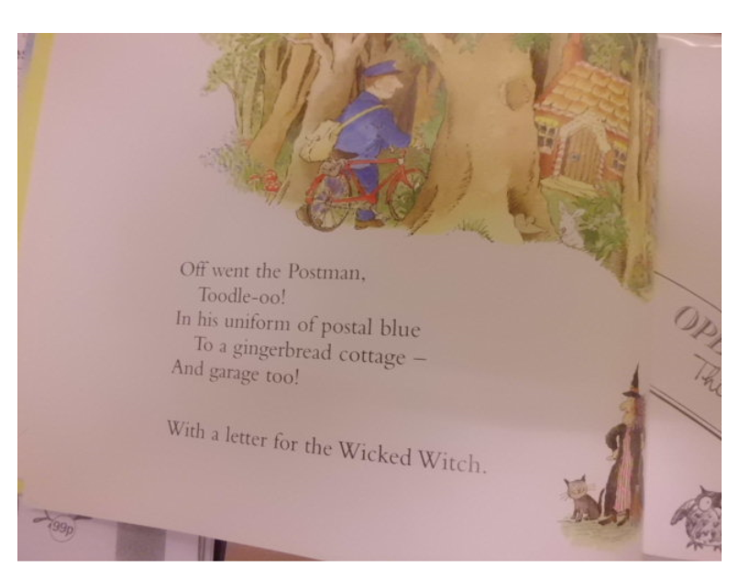

Slide 10
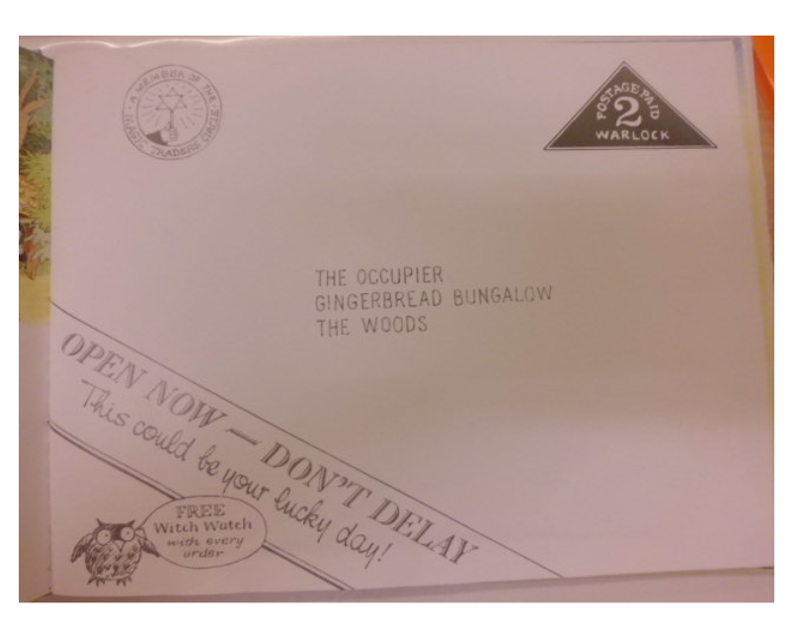

Slide 11
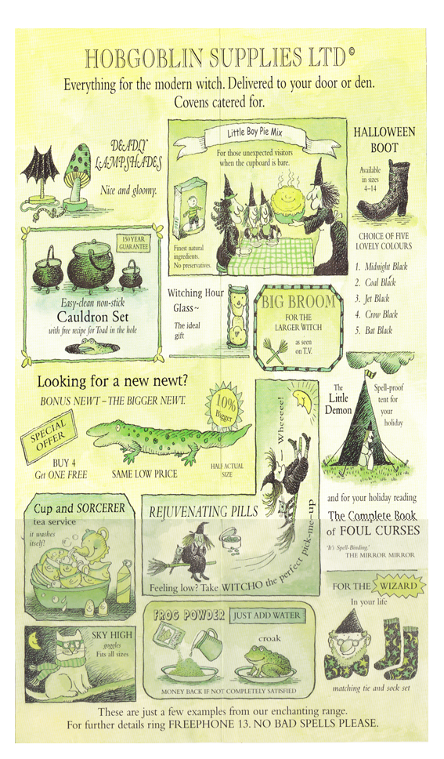
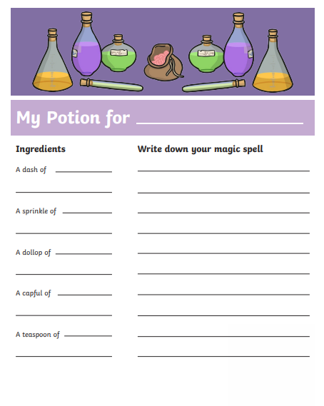
Activity Two:
Create your own potion and write a spell! Be creative!

Slide 12
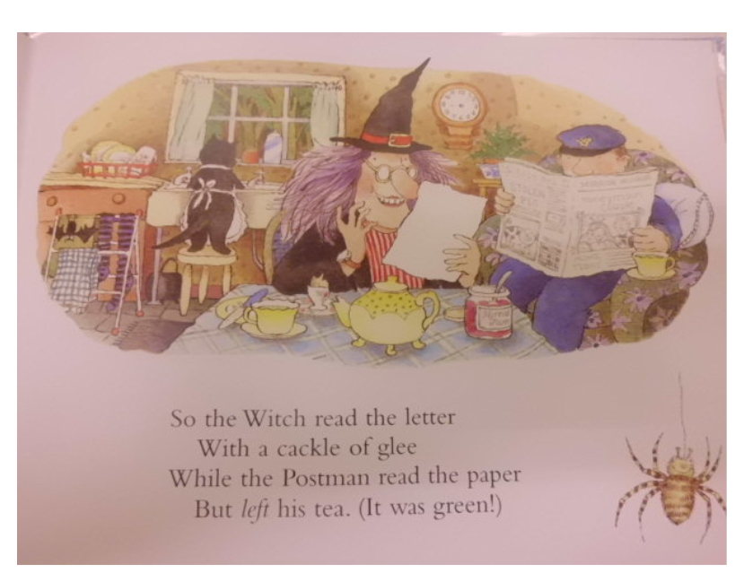

Slide 13
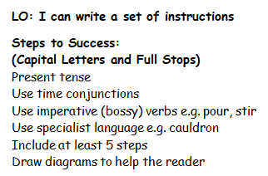
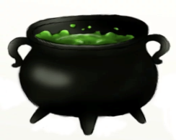
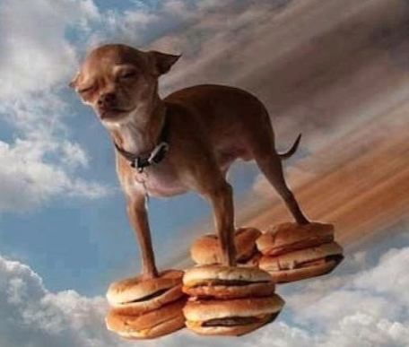
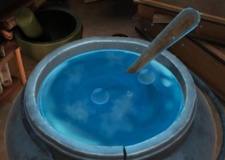
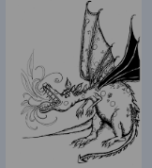
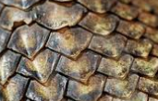
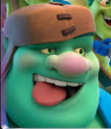
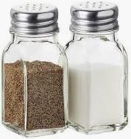
Activity Three: Write a set of instructions ‘How to Make a Magic Potion’ or ‘How to Make a Secret Spell ’What does your spell do?
My spell makes my dog bigger until he is big enough for me to ride to Spain on his back.
Ingredients
A dragon’s cough
A cat’s whisker
2 lizard scales
A goblin’s laugh
Salt and pepper.
Method
First, put the cauldron on the fire.
Then add the cat’s whisker and stir five times .
After that, put in a dragon’s cough.
Next add the lizard scales and the goblin’s laugh.
5. Finally put in some salt and pepper and boil it up.
1st
2nd
3rd
4th
5th

Slide 14
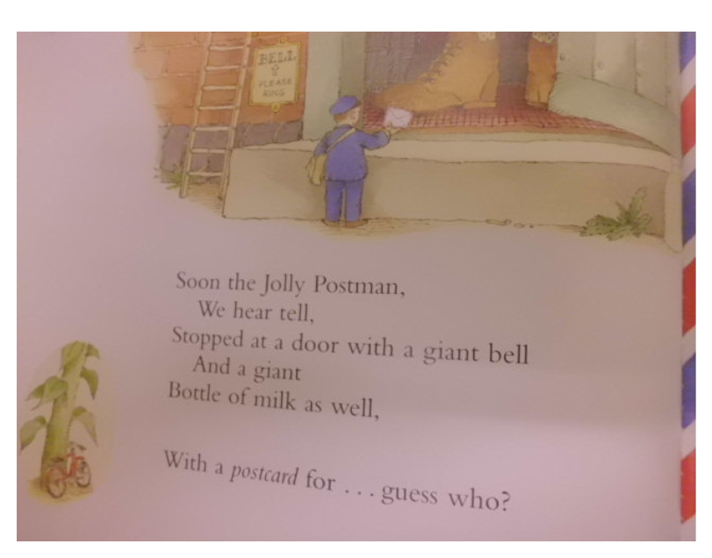

Slide 15
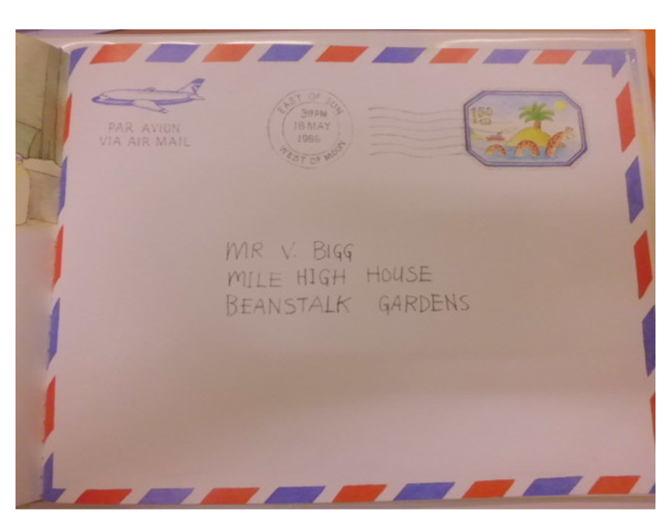

Slide 16
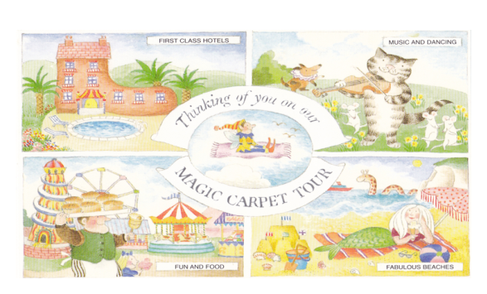

Slide 17
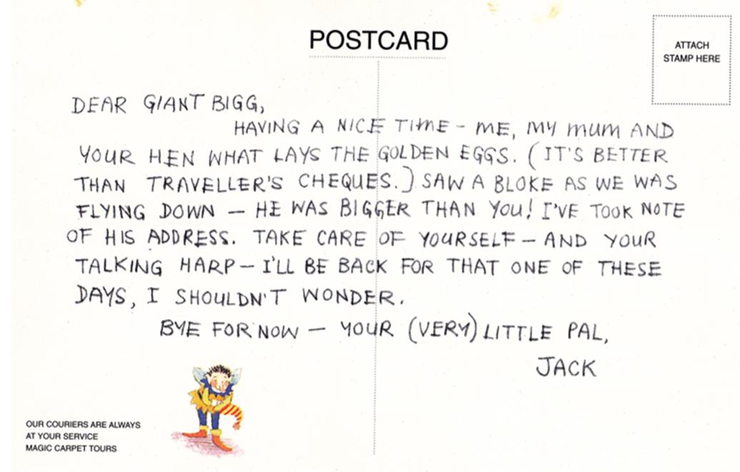
Activity Four : Write a postcard using first person (as if you are Jack). Where have you been? What have you seen?

Slide 19
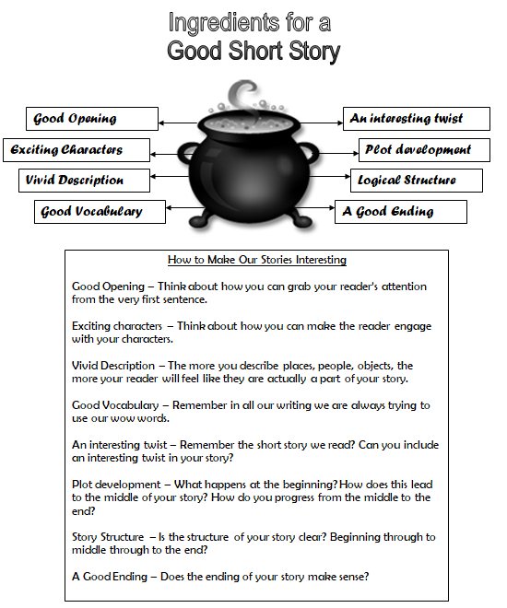
Activity Five: Time to write a story.
Think of our ‘Snail and the Whale’ book and all of their adventures and sing our continents song to remind you of the different places Jack could visit. Write a story all about Jack’s adventures with all of his gold! He can visit anywhere in the world. How does he travel? What does he see? Who does he meet? What does he do? Remember a good story needs a beginning, middle and an end.

Slide 20
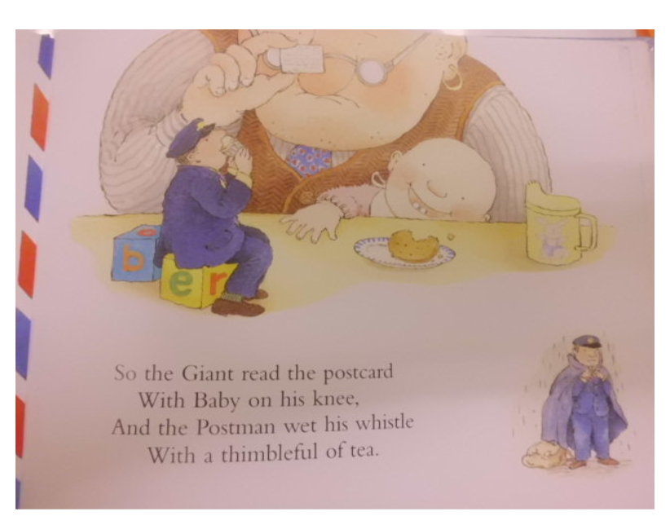

Slide 21
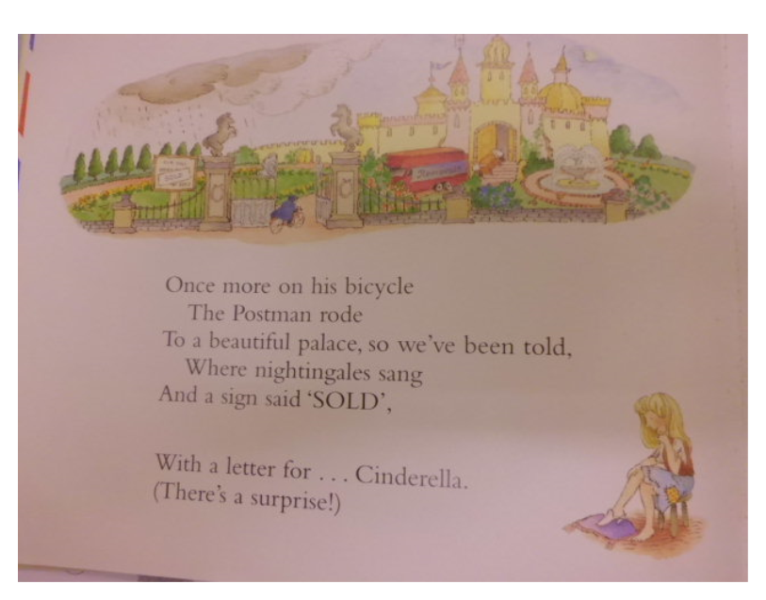

Slide 22
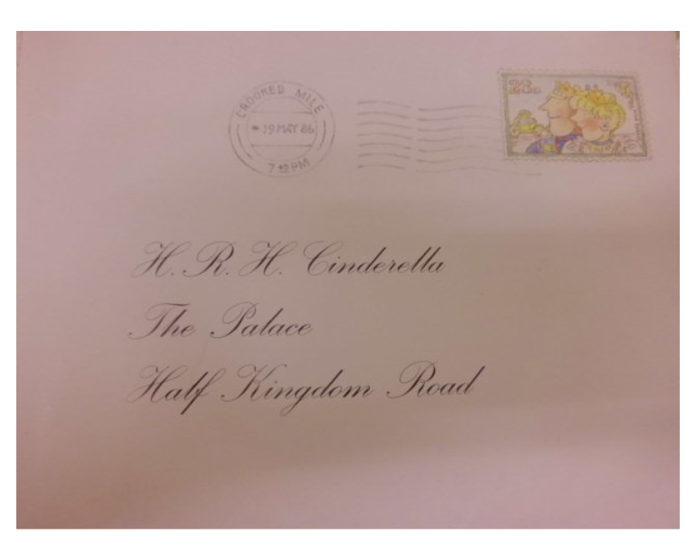

Slide 23
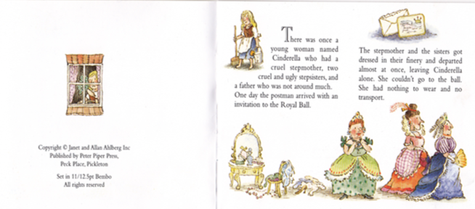
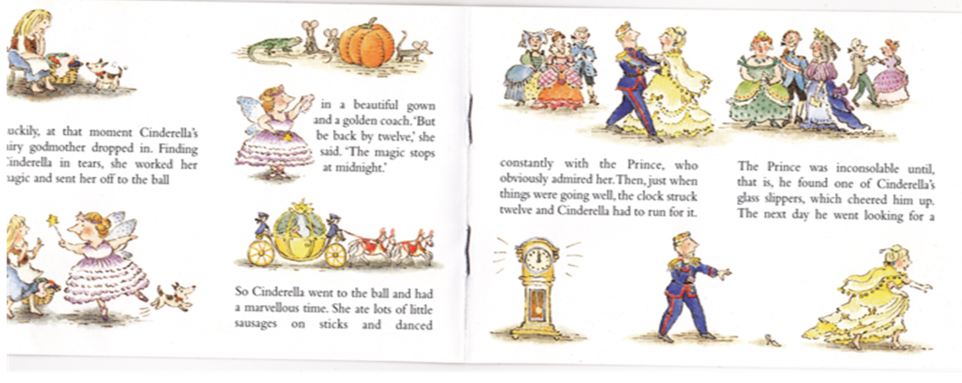

Slide 24
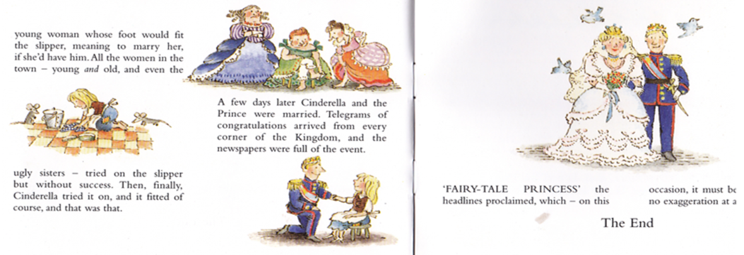
Activity Six: Watch a Disney movie about a princess. You can get a week’s free trial on: https://www.disneyplus.com/en-gb/
Retell a story about your favourite princess.
Activity Seven: Create a comic strip of your favourite part of the movie.

Slide 25
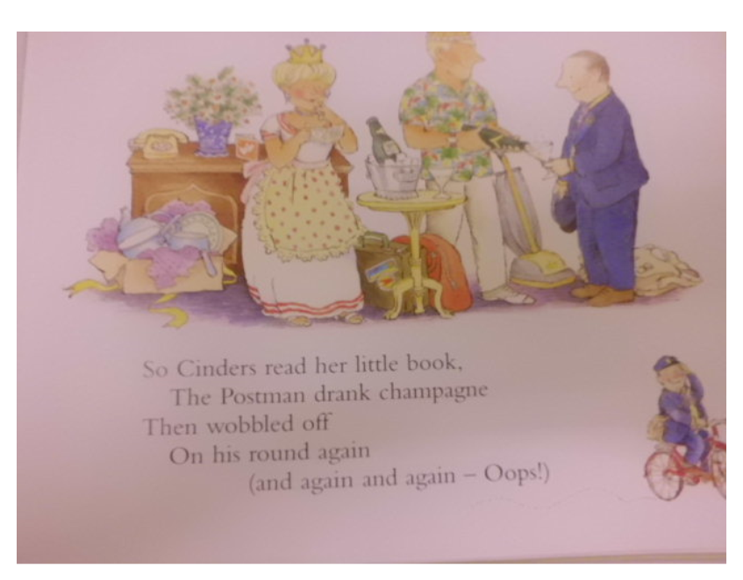

Slide 26
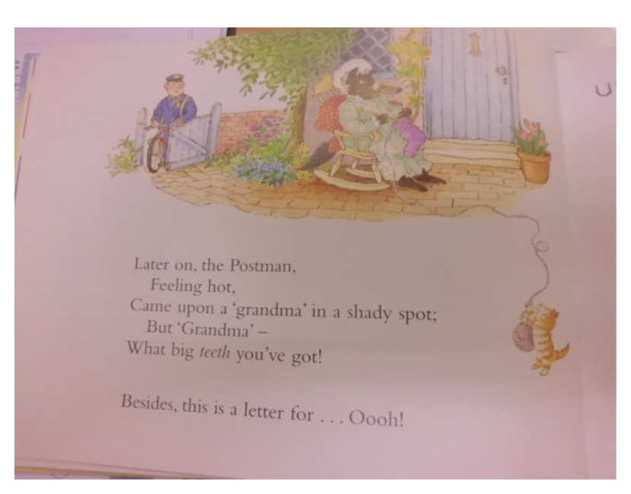

Slide 27
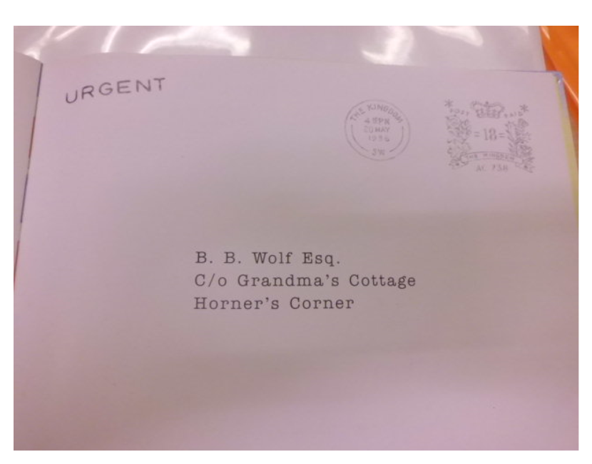

Slide 28
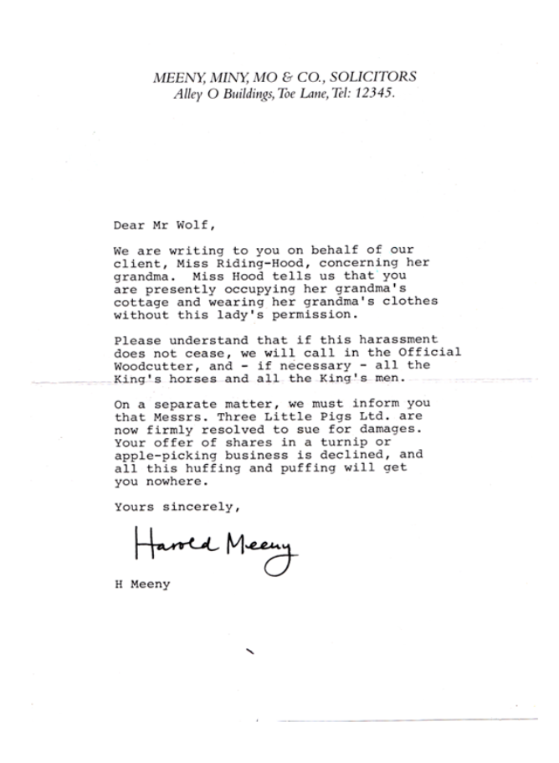
Activity Eight: Draw a picture to show how Mr Wolf reacted to the letter. Remember he is dressed as grandma! Write adjectives to describe him.

Slide 29
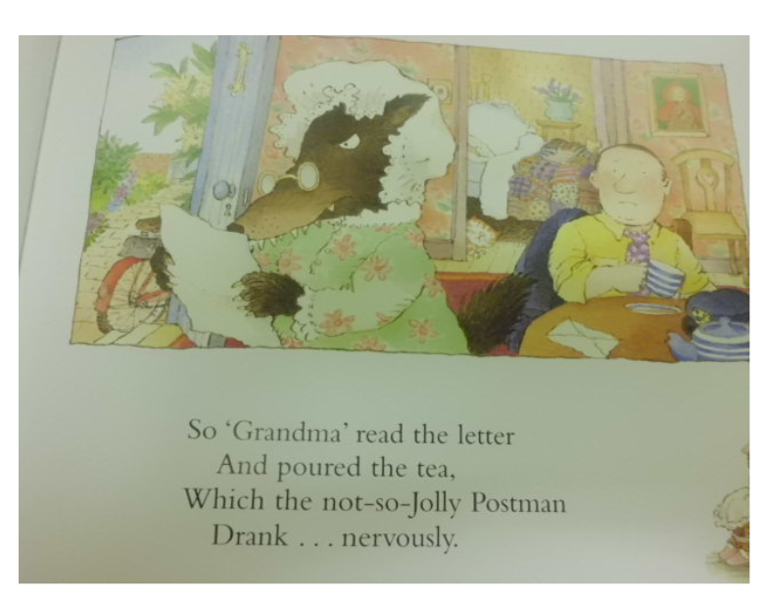

Slide 31
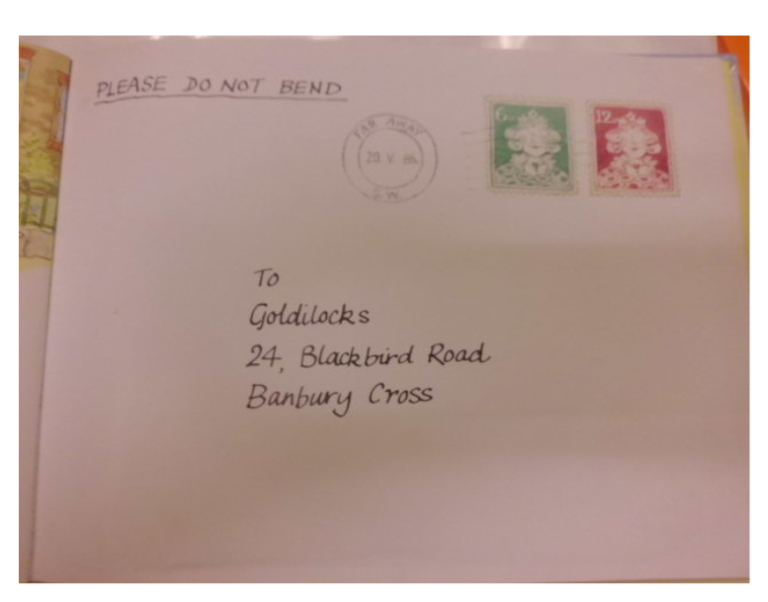

Slide 32
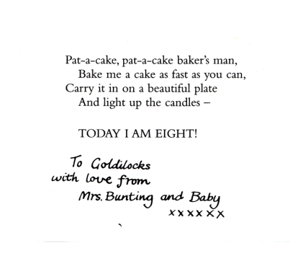
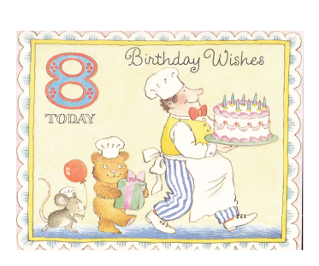
Activity Nine: Write invitations using the first person as if you are Goldilocks. Who will you invite? What time is the party? Where is it? What is the party theme?

Slide 33
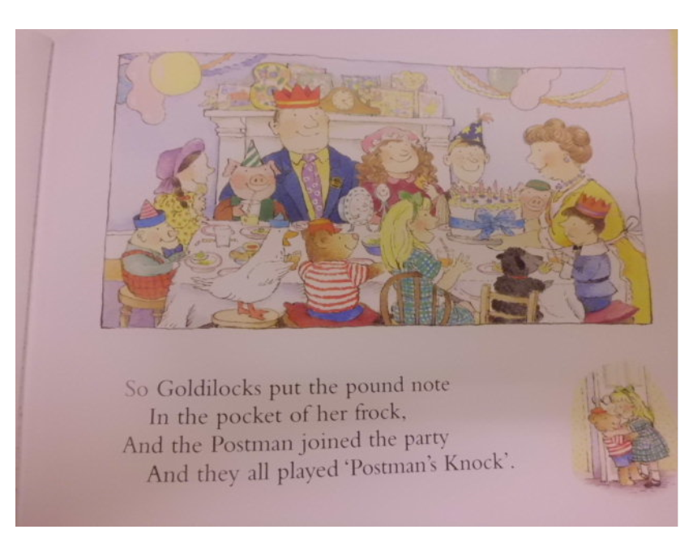

Slide 34
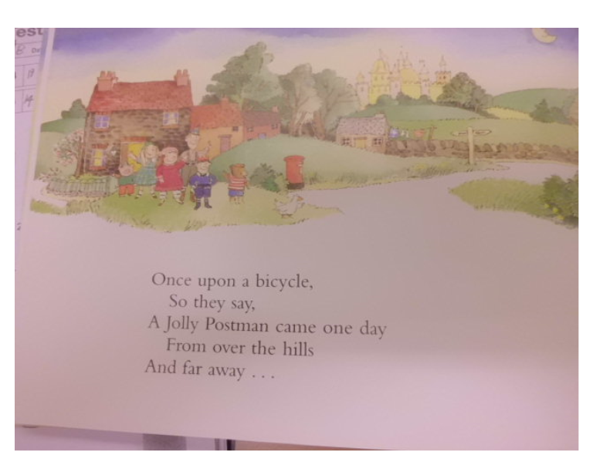

Slide 35
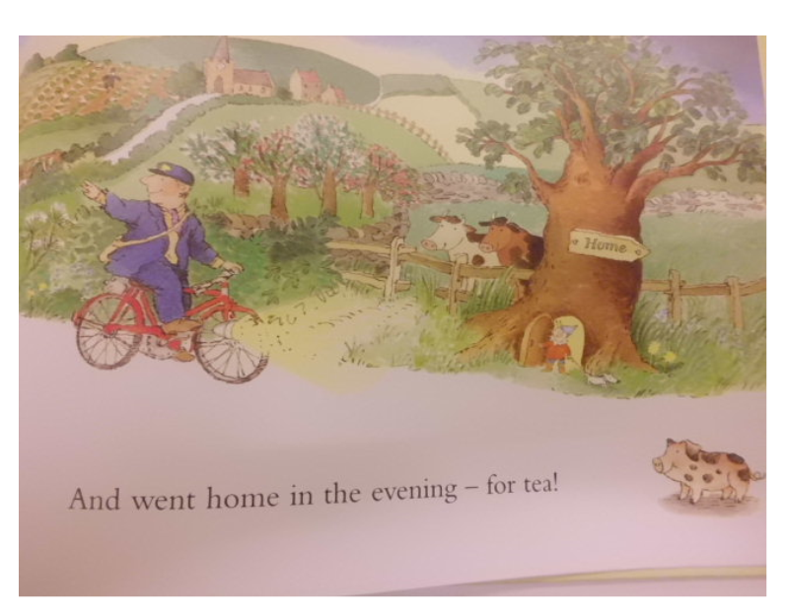

Slide 36
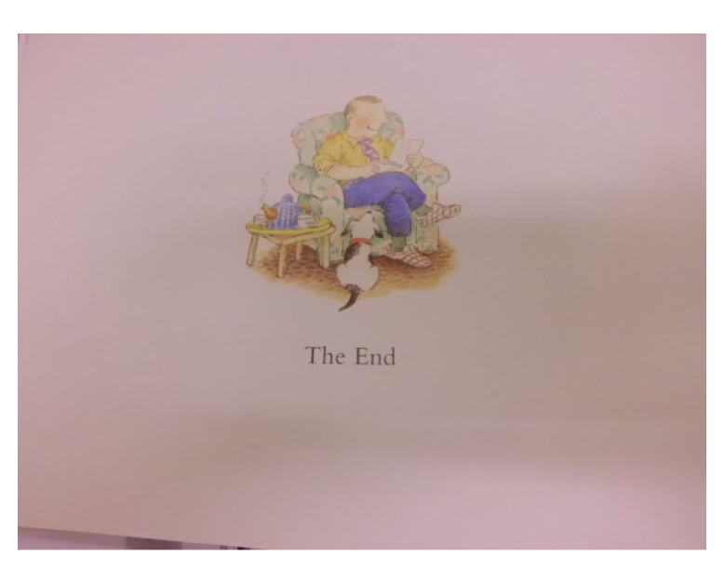
Activity Ten: Write a diary entry
from the Jolly Postman’s point of
view using the first person
(pronoun- I) and a chatty style of
writing.
Remember to include his
feelings, thoughts and to write
about his day in chronological
order.
Top Tip: Read books like ‘Diary of
A Wimpy Kid’ or ‘Diary of a
Killer Cat’ to help you to write a
fantastic diary.
There’s a poster on the next slide to remind you about
the features of a diary entry.

